Slide 1
MINING User behaviors in social networks
Meng Jiang
www.meng-jiang.com

Slide 2
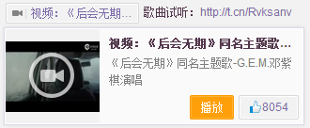


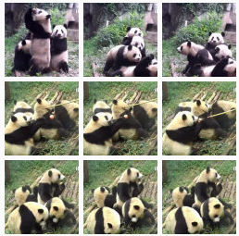
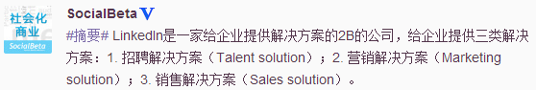
Why Do User Behavior Mining?
User-centric apps give us user behavioral data
User behaviors bring new problems and new apps

Slide 3
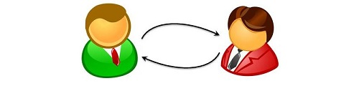
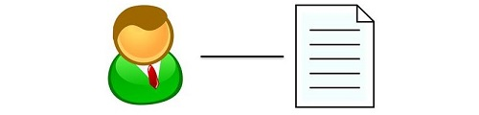

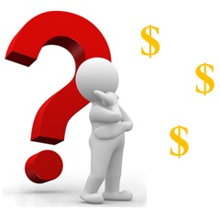
Behavior = Intention + Link
 | Influence mining Community detection Friend recommendation | Behavior prediction Recommendation Behavior pattern discovery
 | Fraud detection Zombie follower detection Suspicious friend requests | Spam detection True/False news Promoting behavior pattern
User-user link
User-item link
Normal use
Anomalous use

Slide 4
Challenging: Social Networks and Users
Large-scale
Relational
Heterogeneous
Complex (intention)

Slide 5
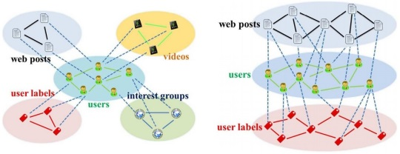
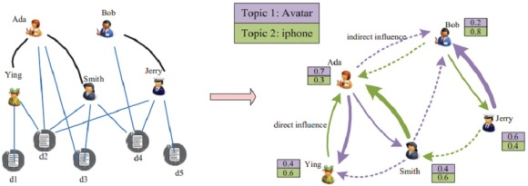
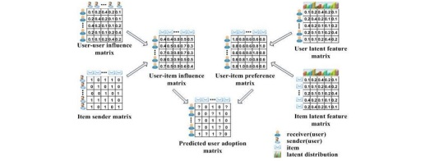
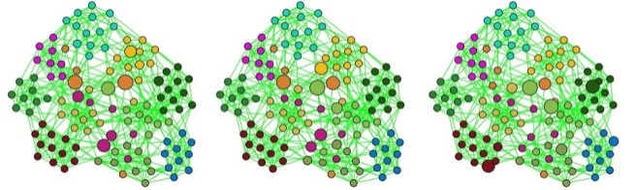
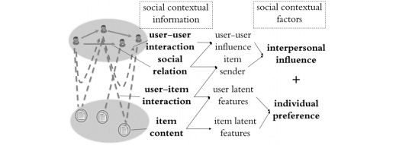
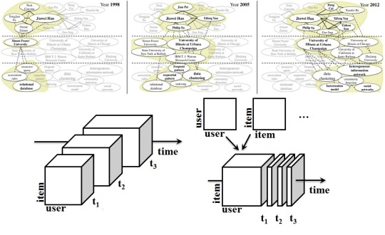
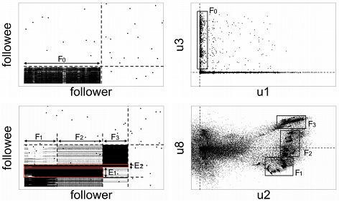
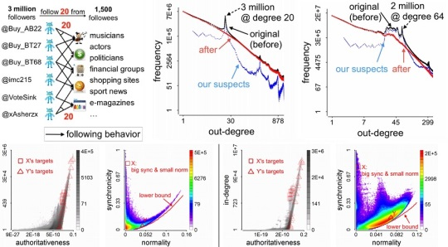
My Works in Mining User Behaviors
User-user link
User-item link
Normal use
Abnormal use

Slide 6
To Be Introduced Today
Social contextual recommendation [CIKM’12+TKDE’14]
Cross-domain social recommendation [CIKM’12]
Behavior discovery and prediction [KDD’14]
Dense bipartite core detection [PAKDD’14]
Fraudulent behavior detection [KDD’14]
Good user-item links
Bad user-user links

Slide 7
Normal Use + User-item Link
User-user link
User-item link
Normal use
Abnormal use

Slide 8


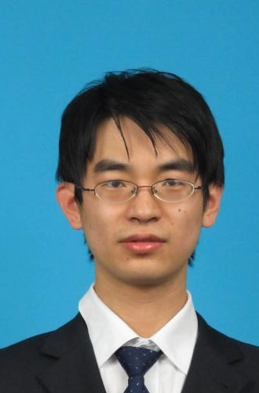

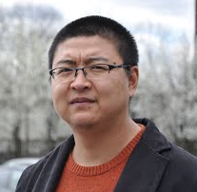
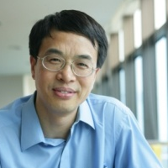

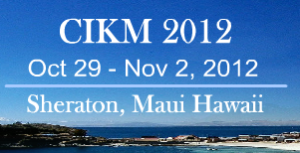
Social contextual recommendation
Meng Jiang
Joint work with Peng Cui, Rui Liu, Qiang Yang,
Fei Wang, Wenwu Zhu and Shiqiang Yang
October 30, 2012 – Maui, HI, USA

Slide 9
Recommender Systems
Predict missing “user-item” links
Predict missing values in “user-item” matrix
Challenge:
High sparsity
Bob
Amy
Tom
Nick
 | Amy | Bob | … | User M
Post 1 | 1 | 1 | … | 0
Post 2 | ? | 0 | … | ?
… | … | … | …
Post N | 0 | ? | … | 1
Post 1
Post 3
Post 2

Slide 10
Our Goals
Given: Links on social networks
Find: A social recommendation framework that best fit users’ adopting behaviors
Goals:
G1. Understand user intention of adoption
G2. A framework for social recommendation
G3. Predict the missing “user-item” links

Slide 11
Links on Social Networks
Target: “user-item” links
Nature: “user-user” links
Can social relation help?
How to use social contextual information?
Bob
social relation
Amy
Tom
user-user
interaction
Nick
user-item
interaction
item content
Post 1
Post 3
Post 2

Slide 12
Related Works
Can we fully use social contextual information?
Q: “Large-scale”? A: “Relational”!
Q: “Relational”? A: “Intention”!
 | Social relation | User-user interaction | User-item interaction | Item content
Content-based & CF | × | × | √ | √
Trust & Influence | × | √ | √ | ×
SoRec & SoReg | √ | × | √ | √
? | √ | √ | √ | √

Slide 13
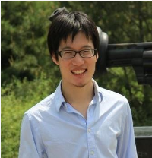
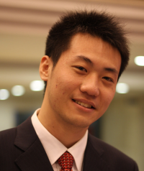
User Intention of Adopting Messages
Peng Cui : Is there anyone who call for paper via Renren? Hah!
http://media.cs.tsinghua.edu.cn/~multimedia/cuipeng/IR_SI_SocialMedia.htm
2011-01-05 13:47 Reply | Share
Call for paper? About social media? Wow!
Personal Preference
This is my best friend and co-author!
Interpersonal influence
Meng Jiang : Support! //Peng Cui : Is there anyone who call for paper via Renren? Hah!
http://media.cs.tsinghua.edu.cn/~multimedia/cuipeng/IR_SI_SocialMedia.htm
2011-01-05 14:05 Reply | Share

Slide 14
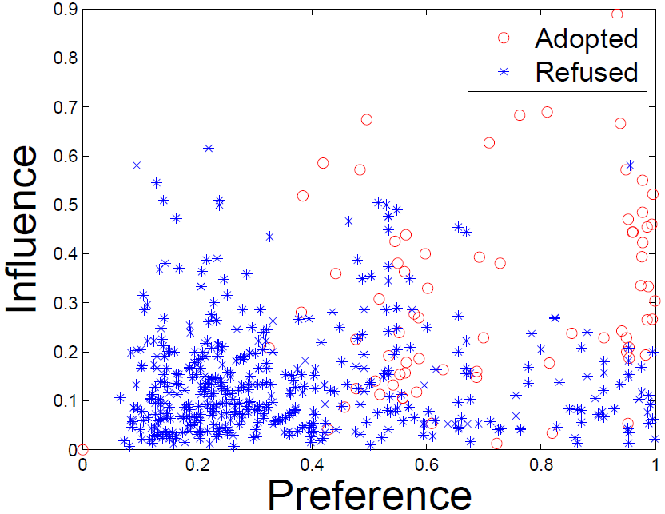
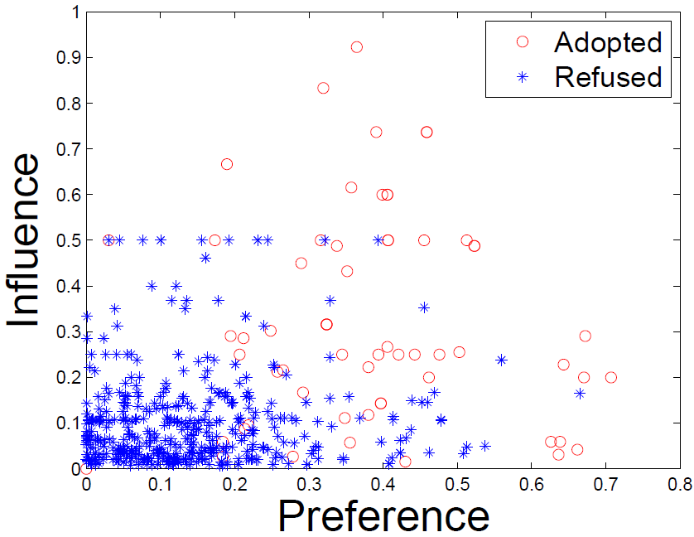
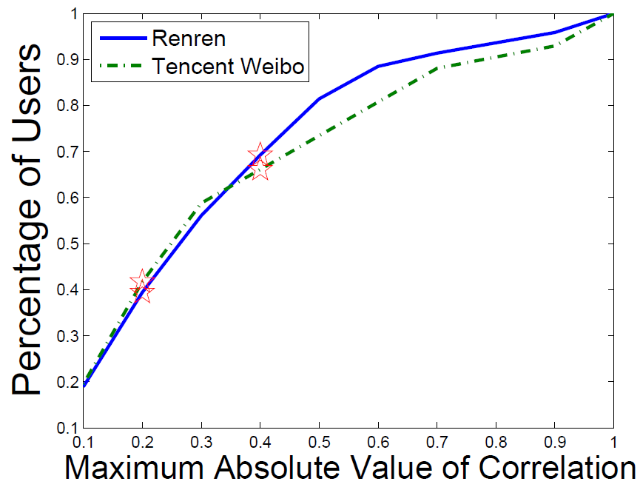
User Intention of Adopting Messages
What is the item content? Who is the sender?
Preference: topic-level user-item similarity
Influence: user-sender interaction frequency
Renren
Tencent Weibo
Correlation(Preference,
Influence) is small.

Slide 15
Social Contextual Information/Factors
item content
item latent feature V
user preference on given item
user-item interaction
user latent feature U
social relation
item sender G
social influence from sender of given item
user-user interaction
user-user influence S

Slide 16
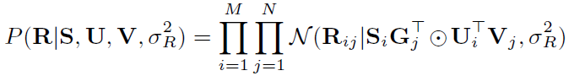
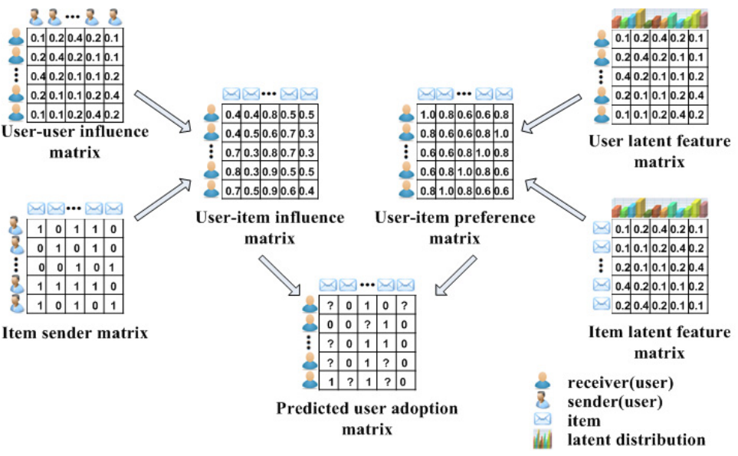
Social Contextual Recommendation
S
U
G
V
R

Slide 17
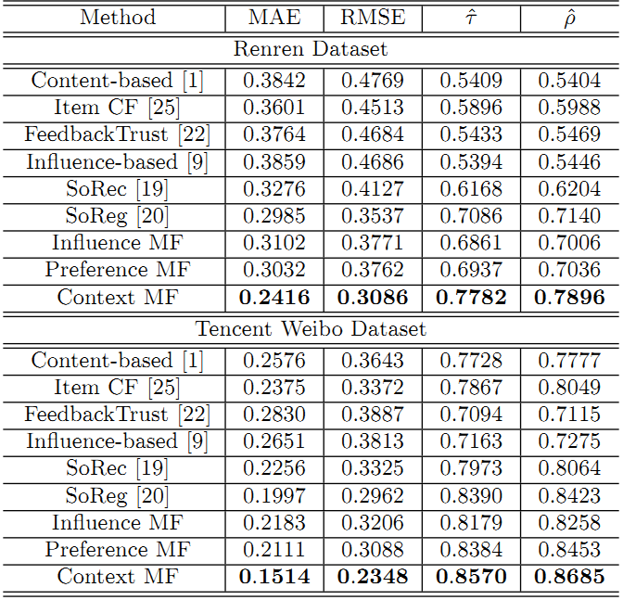
Effectiveness in Predicting Missing Links
 | Renren | Tencent Weibo
MAE | -19.1% | -24.2%
RMSE | -12.8% | -20.7%
Kendall’s | +9.82% | +2.1%
Spearman’s | +10.6% | +3.1%

Slide 18

Scalable recommendation with Social contextual information
Meng Jiang
Joint work with Peng Cui, Fei Wang, Wenwu Zhu and Shiqiang Yang
TKDE 2014 (IF=1.815, 5-year IF=2.573)

Slide 19
Our Goals
Given: Links on social networks
Find: A social recommendation framework that fast and best fit adopting behaviors
Goals:
G1. Understand user intention of adoption
G2. A scalable framework for recommendation
G3. Fast predict the missing “user-item” links

Slide 20
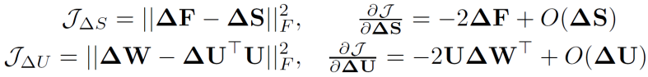
New Users Coming
 | Old N items | New ΔN items
Old M users | Done! O(k²L(M+N)²) | O(k²LΔNN) << O(k²LN(M+N))
New ΔM users | O(k²LΔMM) << O(k²LM(M+N)) | Sorry… Cold-start problem
item
user+new user
user+new user
^{adoption}
item
user
^{item content}
^{social relation}
interaction frequency
item
user+new user
user+new user
new user
?

Slide 21
New Items Coming
 | Old N items | New ΔN items
Old M users | Done! O(k²L(M+N)²) | O(k²LΔNN) << O(k²LN(M+N))
New ΔM users | O(k²LΔMM) << O(k²LM(M+N)) | Sorry… Cold-start problem
item
new item
item+new item
user
user
^{adoption}
?
^{item content}
^{social relation}
^{interaction frequency}
user
item+new item
user
user

Slide 22
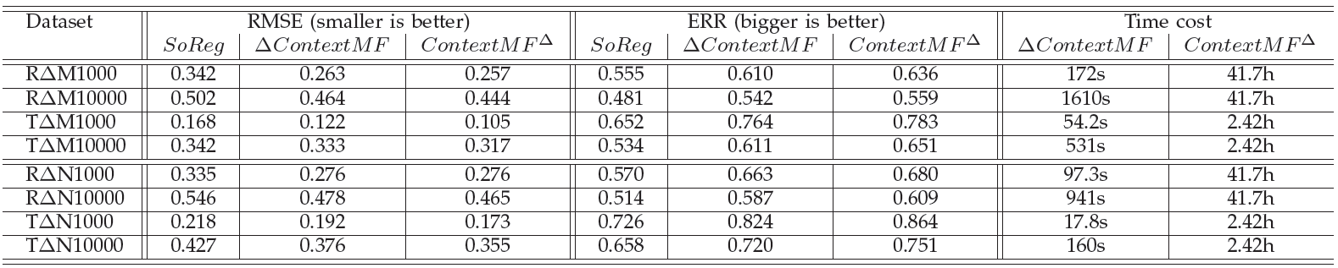
Efficiency in Incremental Data
Better than SoReg [Ma et al. WSDM 2011]
A little bit worse than offline learning (re-training)
Save time from hours to minutes when (M,N ~ million) and (ΔM,ΔN ~ thousand)

Slide 23
Normal Use + User-item Link
User-user link
User-item link
Normal use
Abnormal use

Slide 24
Social recommendation across multiple relational domains
Meng Jiang
Joint work with Peng Cui, Fei Wang, Qiang Yang,
Wenwu Zhu and Shiqiang Yang
November 1, 2012 – Maui, HI, USA

Slide 25
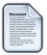

Recommender Systems
Predict missing “user-item” links
Challenge:
Cold-start and extremely high sparsity
cold-start
new user
web posts
?
users
?
high sparsity

Slide 26
Multiple Domains
User label domain
Choose < 10 from 200+ labels like ‘iPhone fan’
Peng Cui
Haidian, Beijing
Company: Tsinghua
User labels (5)
Tsinghua, Ph.D., World Wide Web,
Social Network, Social Media
Meng Jiang
Haidian, Beijing
University: Tsinghua
User labels (9)
Chinese food, World Wide Web,
Social Network, Data Mining, Liverpool Football Club, NBA, Humors, Sports, Ph.D. Candidates

Slide 27
Our Goals
Given: Links on social networks
Find: A framework that use auxiliary knowledge in multiple domains to best predict “user-item” (target) links when the training set is too small.
Goals:
G1. Understand link formations on social networks
G2. A social network framework with multiple domains
G3. Solve the cold-start problem

Slide 28
Challenges: Multiple Domains
Relational
Within-domain links and cross-domain links
Heterogeneous
Different types of item domains
Sparse
Different sparsity levels

Slide 29
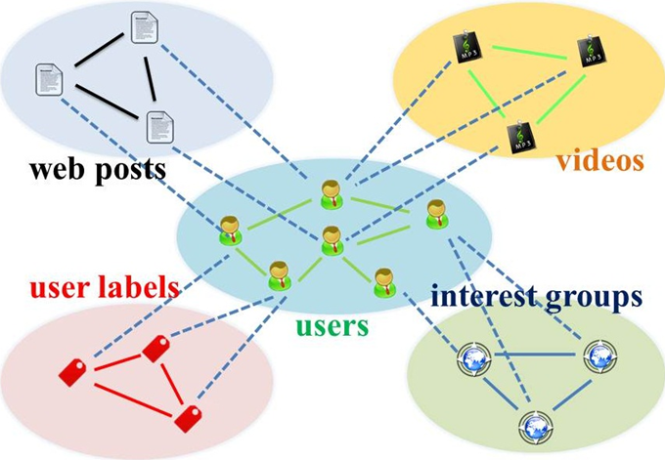
Star-structured Graph
Key idea: use “social relation” domain as bridge

Slide 30
Star-structured Graph
Method: Transfer learning + Random walk with restarts

Slide 31
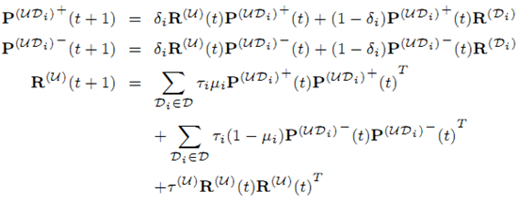
Hybrid Random Walk
On high-order star-structured graph

Slide 32
Data Set
Tencent Weibo (January 2011)
Domain | Size | Cross-domain links
 |  | Accept | Refuse
User | 53.4K | — | —
Web post | 142K | 1.47M (0.02%) | 3.40M (0.04%)
User label | 111 | 330K (5.57%) | —

Slide 33
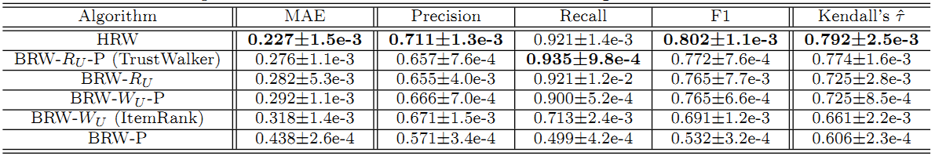
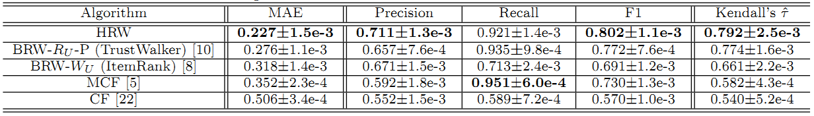
Good to Transfer!
Compare with RWR models
Compare with Baselines

Slide 34
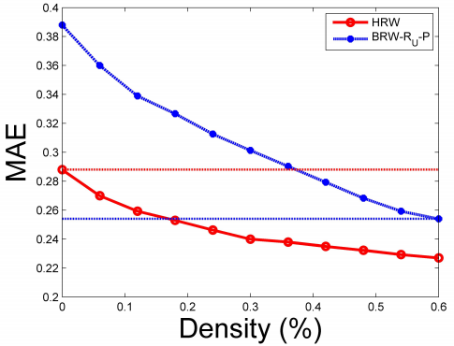
Insights
If we do transfer (from user-label domain), we need only ~30% to reach the same performance.
Advice: build more apps for new users to give more info.
0 user-post
100% user-label
35% user-post
60% user-post
18% user-post
100% user-label

Slide 35
Normal Use + User-item Link
User-user link
User-item link
Normal use
Abnormal use

Slide 36

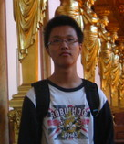

FEMA: Flexible evolutionary Multi-faceted analysis for dynamic behavior pattern Discovery
Meng Jiang
Joint work with Peng Cui, Fei Wang, Xinran Xu, Wenwu Zhu and Shiqiang Yang
August 25, 2014 – NYC, USA

Slide 37



Behavior Analysis
Modeling
How to formulate human behavior?
Pattern discovery
How to understand human behavior?
Prediction
What is the missing human behavior?
KDD’13
?
KDD’14

Slide 38
Our Goals
Given: Behavior data sequence
Find: A behavior analysis framework that fast and best discovers behavior patterns
Goals:
G1. Model the human behavior
G2. Understand the hidden patterns
G3. Predict the missing behavior

Slide 39



Human Behavior - OLD
Write a paper
Post a Facebook message
+
+

Slide 40
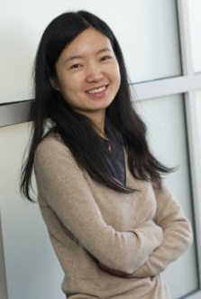

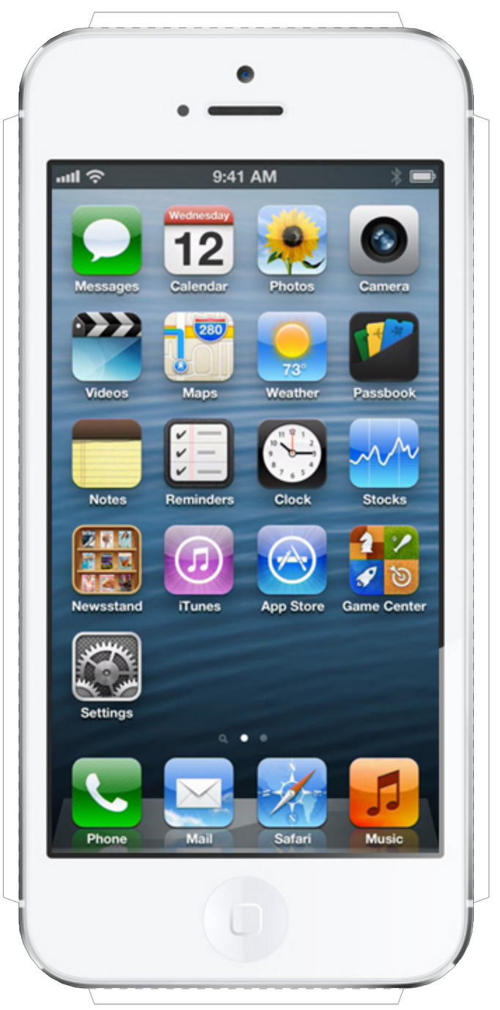
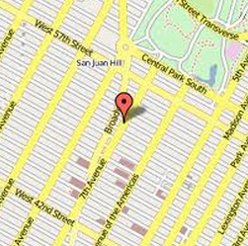

Human Behavior: Multi-faceted
Write a paper
Post a Facebook message
{
+
}
+
+
{
+
}
+
+
+
+

Slide 41
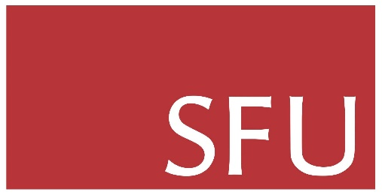

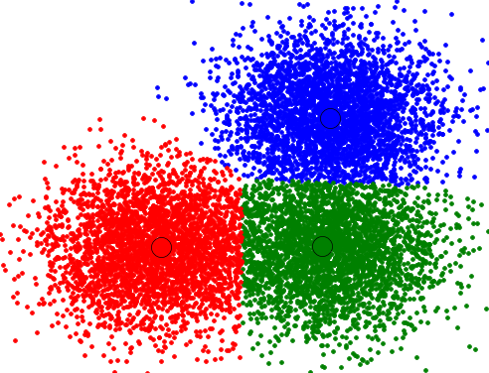
Human Behavior: Dynamic
Write a paper
time
time
DB
time

Slide 42
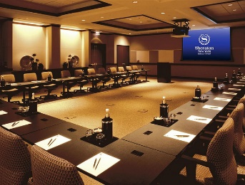
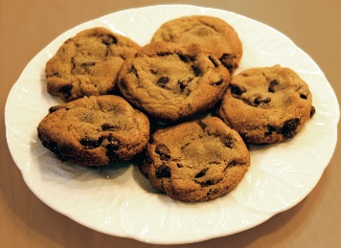
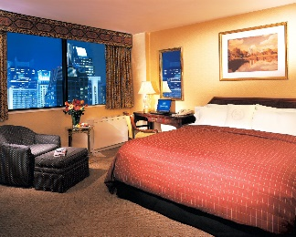
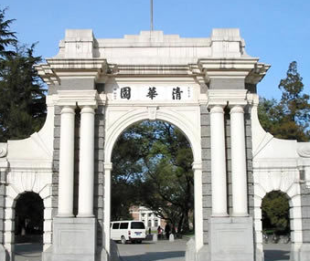



Human Behavior: Dynamic
Post a Facebook message
Hour
talk
tea break
travel
sleep
time
Month
Tsinghua
WWW’14
Tsinghua
KDD’14
time

Slide 43
Model Human Behavior
time
Human behavior
affiliation
keyword
author
Problem
Tensor sequence
Multi-faceted
Behavior modeling
Dynamic
Pattern discovery
Decomposition
Completion
Behavior prediction
≈
x
x

Slide 44
Challenges
High sparsity
High-order tensors
High complexity
Long sequence of tensors
Too slow if decomposing at each time
time
t₃
t₂
item
t₁
user

Slide 45
Idea
High sparsity
Auxiliary knowledge from regularizations
user
item
…
user
item
time
t₃
t₂
time
item
t₃
t₁
user
t₂
item
t₁
user

Slide 46
Idea
High complexity
Update projection matrices with new coming piece of data
user
item
…
user
item
time
t₃
t₂
item
item
time
t₁
user
user
t₁
t₂
t₃

Slide 47
FEMA: Flexible Evolutionary Multi-faceted Analysis
0~t
Δt
0~(t+Δt)
X
+
ΔX
item
item
user
√
user
×
matricizing
update
item
cluster
λ
core tensor
X⁽¹⁾
user
cluster
user
decompose
user
cluster
X⁽²⁾
A⁽¹⁾
item
user
projection matrix
item
cluster
L⁽¹⁾
L⁽²⁾
user
item
A⁽²⁾
regularize
item
user
item

Slide 48
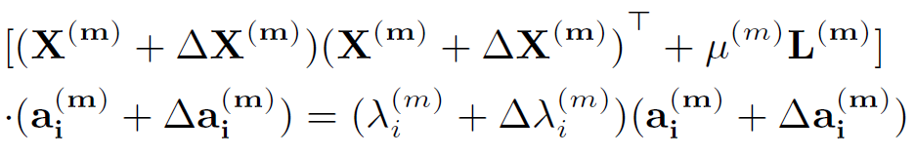
FEMA: Flexible Evolutionary Multi-faceted Analysis
0~t
Δt
0~(t+Δt)
X
+
ΔX
item
item
user
√
user
×
matricizing
update
item
cluster
λ
core tensor
user
cluster
Tensor Perturbation Theory
X⁽¹⁾
user
decompose
user
cluster
X⁽²⁾
A⁽¹⁾
item
user
projection matrix
item
cluster
L⁽¹⁾
L⁽²⁾
user
item
A⁽²⁾
regularize
item
user
item

Slide 49
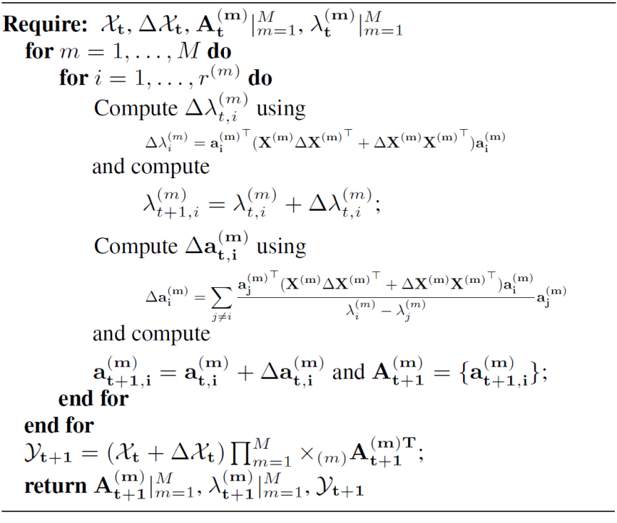
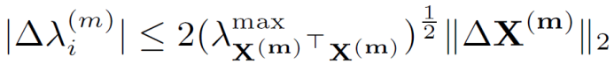
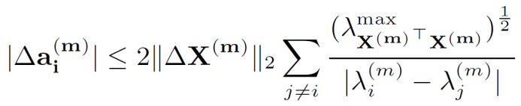
FEMA Algorithm
Approximation
Bound Guarantee
core tensor
projection matrix

Slide 50
Data Sets
Microsoft Academic Search
Subset of top 100 experts from query “data mining”
Paper: <author, affiliation and keyword>
Regularization: co-authorship <author, author>
7,777 x 651 x 4,566 x 32 years: 171,519 tuples
Tencent Weibo
43 days: Nov. 9, 2011 to Dec. 20, 2011
Tweet: <user-who-@, @-ed-user, word>
Regularization: social relation <user, user>
6,200 x 1,813 x 6,435 x 43 days: 519,624 tuples

Slide 51
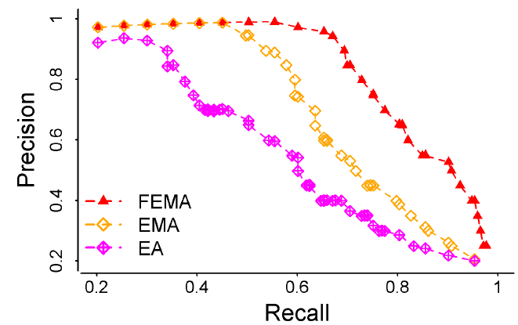
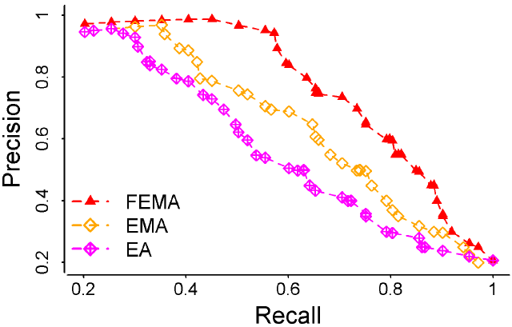
Leveraging Multi-faceted Information
Predict “Who”-“What keyword”
FEMA uses “Where” (affiliation).
Predict “Who”-“@Whom”
FEMA use “What” (tweet word).
 | Microsoft Academic Search |  | Tencent Weibo
 | MAE | RMSE | MAE | RMSE
FEMA | 0.735 | 0.944 | 0.894 | 1.312
EMA | 0.794 | 1.130 | 0.932 | 1.556
EA | 0.979 | 1.364 | 1.120 | 1.873
Precision vs Recall
X
L
X
X

Slide 52


Leveraging Flexible Regularizations
“Who”-“Where”-“What keyword”?
“Who”-“@Whom”-“What”?
 | Microsoft Academic Search |  | Tencent Weibo
 | MAE | RMSE | MAE | RMSE
FEMA | 0.893 | 1.215 | 0.954 | 1.437
EMA | 0.909 | 1.466 | 0.986 | 1.698
DTA [Sun et al.] | 0.950 | 1.556 | 1.105 | 1.889
HOSVD | 1.047 | 1.618 | 1.220 | 2.054
CP | 1.055 | 1.612 | 1.243 | 2.117
Precision vs Recall
X
L
X

Slide 53



Efficiency, Loss and Parameters
Re-decompose
updated matrices
Insensitive to
regularization weight
Evolutionary analysis:
update λ and a with ΔX
Evolutionary analysis:
update λ and a with ΔX
Re-decompose
updated matrices

Slide 54
Visualization: Test Pattern Discovery
Microsoft Academic Search
Tencent Weibo
Behavior Patterns
Multi-faceted
Dynamic

Slide 55

Microsoft Academic Search

Slide 56

Microsoft Academic Search

Slide 57

Microsoft Academic Search

Slide 58

Tencent Weibo

Slide 59

Tencent Weibo

Slide 60
Abnormal Use + User-user Link
User-user link
User-item link
Normal use
Abnormal use

Slide 61




Catchsync: catch synchronized behavior in large directed graphs
Meng Jiang
Joint work with Peng Cui, Alex Beutel,
Christos Faloutsos and Shiqiang Yang
August 26, 2014 – NYC, USA
Notes:
Hello everyone, welcome to listen to our work. My name is Meng Jiang. I am from Tsinghua University in Beijing. Our work’s title is CatchSync: Catch Synchronized Behavior in Large Directed Graphs. This is a joint work with Peng Cui and Shiqiang Yang from Tsinghua, and Alex Beutel and Christos Faloutsos from Carnegie Mellon University.

Slide 62










Fraud Detection: Graph Analysis Problem
[www.buyfollowz.org]
[buymorelikes.com]
Notes:
Fraud detection is an important problem for social networks. As the advertisements show here, there are some companies selling Twitter followers and Facebook “Likes” to inflate those numbers of their customers. How to catch the fraudsters can be considered as a graph analysis problem. We are looking for anomalous edges that are created by fraudulent behaviors instead of natural behaviors in the million-node graphs. For example, here we are trying to distinguish the botnets from the Simpson family.

Slide 63
Our Goals
Given: A graph (large-scale, directed, etc.)
Find: Fraudulent behavior = Anomalous edges
Goals:
G1. Find patterns that distinguish fraudulent user behavior from normal behavior
G2. Design algorithms that catch fraudsters
Notes:
So here are our goals. Given us a graph. It could be very large. It could be directed or bi-partite. How can we find the fraudulent behaviors that create anomalous edges? Our goals towards this problem are: first, to find the patterns that can distinguish fraudulent behavior from natural behavior; second, understanding the patterns we can design algorithms that can catch the fraudsters.

Slide 64



Anomalies in Degree Distributions
Power-law distribution
DBLP Author-publication | Flickr User-user | Twitter Who-follows-whom
[konect.uni-koblenz.de/networks/]
Notes:
If there are fraudsters manipulating the social graphs, will the degree distributions show something strange? Let’s have a look at the out-degree distributions of these graphs. The figures are from a website in Germany called KONECT. The X-axis is out-degree, for example, how many publications an author has in DBLP. The Y-axis is the frequency of users. The figures are plotted in log-log scale. You can see the DBLP and Flickr networks show smooth power-law distributions. But the Twitter graph shows some spikes. There must be some anomalies.

Slide 65

Anomalies in Degree Distributions
2009
3.17M
0.41M
41M
d=20
Notes:
Let’s replot the distribution to make it clear. In the Twitter 2009 graph with 41 million nodes, we can see a spike of almost 3 million nodes in the out-degree distribution at degree 20. We can also see some other spikes.

Slide 66
Anomalies in Degree Distributions
2009
3.17M
0.41M
41M
d=20
Notes:
If we want to distinguish the accounts in Twitter that make those spikes, we just know some suspicious degree numbers, but there are still 0.41 million innocent people.

Slide 67
Linear Classifier with “Degree”: Fail
+1
(Fraud)
=20?
Label (+1,-1) | Out-degree
classifier
×
Notes:
If we build a linear classifier with the out-degree values to catch the fraud, it will fail. So the spikes can tell us the existence of anomalies but they cannot give us the way to catch them.

Slide 68


Anomalies in Degree Distributions
2011
1.91M
117M
0.44M
d=64
Notes:
The anomalies do not only happen on Twitter. In Tencent Weibo, a microblogging platform in China, we can also see spikes on its out-degree distribution.

Slide 69
Question 1: Spikes?
Is the million-user spike caused by natural or fraudulent behavior?
Notes:
So here we have the Question 1: Is the million-user spike caused by natural or fraudulent behavior? How to explain the spikes? If it shows frauds, how can we catch them?

Slide 70
Traditional Fraud Detection
+1
(Fraud)
Big?
Small?
Big?
Big?
Big?
Label (+1,-1) | Out-degree | In-degree | #tweet | #url in tweets | #hashtag in tweets
Content-based
features
classifier
Notes:
The traditional fraud detection methods are collecting a number of features of account and use supervised or semi-supervised algorithm to classify the account. For example, if a user has lots of followees, which means the out-degree is big, it has a high probability to be a fraudster. Other clues can be a small number of followers and suspicious user generated content. If a user posts lots of tweets, lots of url links or lots of hashtags in his tweets, he is probably a fraudster or spammer.

Slide 71



Empty Profile?
Notes:
However, the fake accounts that are trying to inflate the number of followers or Likes are usually smart. See here is one of the fake followers bought by a scholar with 5 dollars. He shows it in his personal website for some study. It has lots of profile information with nice photo and nice self-introduction. It has only 17 tweets. There is no url and hashtag in the 17 tweets. With the content , it’s hard to say this account must be bad.

Slide 72



Few Followers?
Notes:
Here is another example. The name is very suspicious. It’s exactly a fraudster. It follows lots of Internet Marketers and shopping sites. But it looks popular. It has 344 followers. This big value of in-degree will make the linear classifier confused.

Slide 73



Many Followings?
Notes:
Should the fraudsters have a big value of out-degree? Here is an example. Its name is Buy_AB22, which is very suspicious. It has only 20 followers and zero tweet. The followees are book authors or Internet Marketers. But the classifier cannot work when the big out-degree assumption is wrong.

Slide 74
Question 2: Content Unavailable?
0, 0, 0… sorry
Label (+1,-1) | Out-degree | In-degree | #tweet | #url in tweets | #hashtag in tweets
Content-based
features
classifier
Notes:
So here is Question 2. If the content-based features are unavailable, how can we catch the fraud? If not the content, what patterns do the fraudsters have to show?

Slide 75




Question 3: Robust to Camouflage?
Target
Popular
camouflage
Random
camouflage
Notes:
For example, besides their targets or customers, they can follow President Obama as “popular” camouflage. They can also follow some random user like you and me for camouflage. The question is how can we give a fraud detection method that can be robust to the camouflage?

Slide 76
Questions
Spikes?
Content unavailable?
Robust to camouflage?
Catch patterns of fraudulent behaviors!
Notes:
Here we summarize the questions: How to explain the spikes? How to solve the fraud detection problem when the content is unavailable? How to give a robust method to catch the fraud? Our idea or answer is to understand what the fraudsters want to do. They want to create links with monetary incentives. So we should catch the patterns of this fraudulent behavior.

Slide 77
Behavior-based Features
Follower
behavior
Followee
behavior
≈
≈
Out-degree
1st left singular vector
(Hubness)
2nd left singular vector
…
In-degree
1st right singular vector
(Authoritativeness)
2nd right singular vector
…
Notes:
To understand the behavior patterns, we first collect some behavior-based features. The behaviors could be follower behavior when we focus on out-going links and followee behaviors when we focus on in-coming links. If we do SVD on the adjacency matrix, the out-going links give us left singular vectors and the in-coming links give us right singular vectors. Here we use the two basic features of each type of links: out-degree and hubness which is the 1st left singular vector for follower behavior, and in-degree and authoritativeness which is the 1st right singular vector for followee behavior.

Slide 78


Behavior-based Feature Space
Follower
behavior
Followee
behavior
Notes:
Then we can plot the feature space of follower behavior and followee behavior. These are heat maps. X-axis is singular vector and Y-axis is the degree. Red for large population and purple for small. We can see anomalies in these feature space though we cannot tell why. Next we will compare the fraudsters and normal users in these feature spaces so that perhaps we can explain the anomalies.

Slide 79





Fraudulent Behavior Patterns
Synchronized
Abnormal
Notes:
For better vision, we plot the feature space in Gray. The triangles are followees of Tsinghua, while the squares are followees of Buy_AB22. Now we can see the fraudsters are consistently connecting to similar people. We call it synchronized. The followees are very different from the majority in the network. We call it abnormal. These two are basic characteristics of fraudulent behavior patterns.

Slide 80



Synchronicity and Normality
Synchronicity
Notes:
We give two group-level concepts, synchronicity and normality to describe user behavior patterns, when we are given a node-level feature space. Synchronicity is computed as average similarity between each pair in one’s followee set.

Slide 81

Synchronicity and Normality
Normality
Notes:
Normality is computed as average similarity between a followee and every single node in the feature space.

Slide 82

Synchronicity-Normality Plot
Notes:
Now we can plot the synchronicity and normality in the same figure. Every dot is a user as follower. Normal users like Tsinghua are in the densest part in synchronicity-normality plot. Fraudster like Buy_AB22 have very big synchronicity and very small normality because their behavior patterns are synchronized and abnormal.

Slide 83
Theorem
For any distribution, there is a parabolic lower limit in the synchronicity-normality plot.
Proof. See our paper ☺
synchronicity
normality
Notes:
About the synchronicity-normality plot, we give a theorem to prove the lower limit in our paper. It is parabolic. The real data shows exactly a parabola on the lower bound.

Slide 84
Experiments
Q1: Does CatchSync remove anomalies?
Degree distribution
Feature space
Q2: Is CatchSync catching actually fraudulent users?
Q3: Is CatchSync robust?
Notes:
In the experiments, we want to answer three questions: first, does CatchSync remove anomalies? We will check the degree distribution and feature space; second, is CatchSync catching actually fraudulent users; third, is CatchSync robust to camouflage.

Slide 85


Q1: Does CatchSync Remove Anomalies?
2009
3.17M
41M
0.41M
d=20
Notes:
How let’s see what we have after we remove anomalous edges caught by CatchSync from Twitter graph. The red curve is the updated degree distribution. It’s smooth and looks like power-law. From the results, we find around 3 million accounts consistently connect to 20 from a pool of 1,500 users who are Internet Marketers, shopping sites or financial groups who need a big number of followers.

Slide 86

Q1: Does CatchSync Remove Anomalies?
2011
117M
Notes:
We also can see the distribution is smoother on Tencent Weibo after CatchSync is performed.

Slide 87


Before CatchSync
Follower
behavior
Followee
behavior
Notes:
Also we check the feature space. Before CatchSync, we can see anomalies like stripes away from the major part.

Slide 88


After CatchSync
Follower
behavior
Followee
behavior
Notes:
After CatchSync, the stripes disappear. The suspicious accounts that we remove with CatchSync are exactly the anomalies in these feature spaces.

Slide 89
Q2: Is CatchSync Catching Actually Fraudulent Users?
173/1,000
237/1,000
Notes:
Second, we want to know if the users we caught are actually fraudulent? We random sample 1,000 account who have the degree values around the spikes. And then we ask 5 volunteers to take a look at their profiles to label them as fraudsters or normal users. They are fraudsters if at least 3 volunteers think they are. We have 173 fraudsters from Twitter data and 237 from Tencent Weibo.

Slide 90
Q2: Is CatchSync Catching Actually Fraudulent Users?
CatchSync
+SPOT
CatchSync
SPOT
OutRank
Notes:
Then we use random walk-based method OutRank, content-based method SPOT, and our method CatchSync to catch them. Our accuracy is 0.751 – much higher than others. If we blame fraudsters caught by either CatchSync for suspicious behavior or SPOT for suspicious content, we can have a better performance to 0.813.

Slide 91
Q2: Is CatchSync Catching Actually Fraudulent Users?
CatchSync
+SPOT
CatchSync
SPOT
OutRank
Notes:
On Tencent Weibo, CatchSync is also better than SPOT and the combination is much better. So our behavior-based method is better and complementary with content-based methods.

Slide 92


Q3: Is CatchSync Robust?
Notes:
Third, is CatchSync robust to camouflage? We use synthetic data to test this. First we generate a random power-law graph and then inject synchronized behaviors on it. We can see the followees are shown as outliers in the feature space. And we can catch the injected followers easily in synchronicity-normality plot.

Slide 93


Q3: Is CatchSync Robust?
Notes:
Then we make the injected folllowers to follow 10% more popular nodes and 10% more random nodes. The injected followees are not outliers now. They hide in the feature space. But our synchronicity-normality plot can still find the inject followers who have synchronized and abnormal behaviors.

Slide 94


Q3: Is CatchSync Robust?
Popular
camouflage
Random
camouflage
Notes:
We do experiments on the synthetic data to test the precision and recall when there are popular camouflage or random camouflage. Our CatchSync is close to the ideal and much better than other graph-based methods. So we claim that CatchSync is robust to camouflage.

Slide 95
Conclusion
Goals
G1. Find patterns that distinguish fraudulent user behavior from normal behavior
A1: Synchronized & Abnormal!
G2. Design algorithms that catch fraudsters
A2: CatchSync!
Remove spikes
Content free
Robust to camouflage

Slide 96
References
Meng Jiang, Peng Cui, Alex Beutel, Christos Faloutsos and Shiqiang Yang. CatchSync: Catching Synchronized Behavior in Large Directed Graphs. The 20th ACM SIGKDD International Conference on Knowledge Discovery and Data Mining (KDD), 2014. (Oral, 14.6%, Best paper final list)
Meng Jiang, Peng Cui, Fei Wang, Xinran Xu, Wenwu Zhu and Shiqiang Yang. FEMA: Flexible Evolutionary Multi-faceted Analysis for Dynamic Behavioral Pattern Discovery. The 20th ACM SIGKDD International Conference on Knowledge Discovery and Data Mining (KDD), 2014. (Oral, 14.6%)
Meng Jiang, Peng Cui, Alex Beutel, Christos Faloutsos and Shiqiang Yang. Inferring Strange Behavior from Connectivity Pattern in Social Networks.The 18th Pacific-Asia Conference on Knowledge Discovery and Data Mining (PAKDD), 2014. (Oral and Long, 10.8%)
Meng Jiang, Peng Cui, Alex Beutel, Christos Faloutsos and Shiqiang Yang. Detecting Suspicious Following Behavior in Multimillion-Node Social Networks. The 23rd international conference on World Wide Web companion (WWW), 2014. (Poster)
Meng Jiang, Peng Cui, Fei Wang, Wenwu Zhu and Shiqiang Yang. Scalable Recommendation with Social Contextual Information. IEEE Transactions on Knowledge and Data Engineering (TKDE), 2014. (Regular, CCF A)
Meng Jiang, Peng Cui, Rui Liu, Qiang Yang, Fei Wang, Wenwu Zhu and Shiqiang Yang. Social Contextual Recommendation. The 21st ACM International Conference on Information and Knowledge Management (CIKM), 2012. (Oral, 13.8%)
Meng Jiang, Peng Cui, Fei Wang, Qiang Yang, Wenwu Zhu and Shiqiang Yang. Social Recommendation across Multiple Relational Domains. The 21st ACM International Conference on Information and Knowledge Management (CIKM), 2012. (Oral, 13.8%)
Lu Liu, Feida Zhu, Meng Jiang, Jiawei Han, Lifeng Sun, Shiqiang Yang. Mining Diversity on Social Media Networks. Multimedia Tools and Applications, 2012.
Lu Liu, Jie Tang, Jiawei Han, Meng Jiang, Shiqiang Yang. Mining Topic-Level Influence in Heterogeneous Networks. The 19th ACM International Conference on Information and Knowledge Management (CIKM), 2010.

Slide 97

Thank you!
www.meng-jiang.com
❤ Friend ❤ Discussion ❤ Collaboration

